Slide 1
Campus Event Management & Feedback Analyzer
PRESENTED BY
ACADEMIC CREDENTIALS
DEPARTMENT & UNIVERSITY
Subhajit Maity
Roll No: 26102410046
Dept. of Computational Sciences
Student Code: BWU/MCA/26/051
Reg No: 26102000168
Brainware University, Kolkata

Slide 2



01. INTRODUCTION
Project Overview & Background
Campus Context
Automated Processing
Actionable Insights
Traditional campus event operations rely heavily on disconnected spreadsheets, paper forms, and slow manual calculations.
Integrates Python analytical engines with pandas and matplotlib to transform structured CSV datasets into interactive dashboards.
Delivers immediate popularity metrics, participant counts, and feedback rating distributions for academic administrators.

Slide 3
02. PROBLEM DEFINITION
Challenges in Campus Event Administration
Manual Tracking Overhead
Delayed Feedback Analysis
Lack of Visual Insights
Manual records lead to high error rates and delay participant list verification.
Post-event evaluation takes days due to manual score aggregation across spreadsheets.
Raw numerical data fails to highlight low-rated events or attendance bottlenecks.

Slide 4
03. CORE GOALS
Project Objectives & Expected Outcomes
01
02
03
Automated Data Pipeline
Statistical Analytics
Visual Analytics
Load and validate CSV datasets for events, registrations, and feedback seamlessly.
Calculate average feedback ratings, registration volume, and popularity scores.
Generate bar charts, rating histograms, and participation breakdown plots.

Slide 5
04. SYSTEM BOUNDARIES
Project Scope & System Boundaries
Target Users
System Constraints
Campus Administrators: High-level performance overview.
File Storage: Relies on standard CSV files instead of SQL databases.
Event Organizers: Registration tracking & score evaluation.
Deployment: Designed for single-campus local executions.
Students: Fast event registration and rating submission.
Analytics: Focuses on descriptive and statistical reporting.

Slide 6
05. SYSTEM COMPARISON
Existing Systems vs. Proposed Solution
Feature | Traditional / Paper System | Proposed Python Analyzer
Data Entry | Manual physical registers | Automated CSV dataset ingestion
Feedback Processing | Slow manual score aggregation | Instant pandas metric calculations
Visualization | None / Static hand-drawn graphs | Automated Matplotlib visual charts
Operational Cost | High labor effort and time usage | Zero cost lightweight application

Slide 7
06. ARCHITECTURE HIGHLIGHTS
Proposed System Key Features
CSV Processing
Feedback Evaluation
Graphical Reporting
Parses events.csv, registrations.csv, and students.csv seamlessly.
Computes mean ratings and flags low-rated sessions instantly.
Generates histograms, bar charts, and participation graphs.

Slide 8


07. TECHNOLOGY STACK
Methodology & Tech Stack
Core Language
Data Engine
Visualization
Storage Layer
Python 3.x for modular script execution.
Pandas library for tabular DataFrame manipulations.
Matplotlib and Streamlit visual components.
Structured CSV files for lightweight record keeping.

Slide 9
08. SYSTEM FLOW
Internal Structure & Data Flow
1. CSV Input
2. Data Validation
3. Metric Computation
4. Chart Render
Read event & registration data
Clean and match student IDs
Calculate mean scores & totals
Produce visual outputs

Slide 10
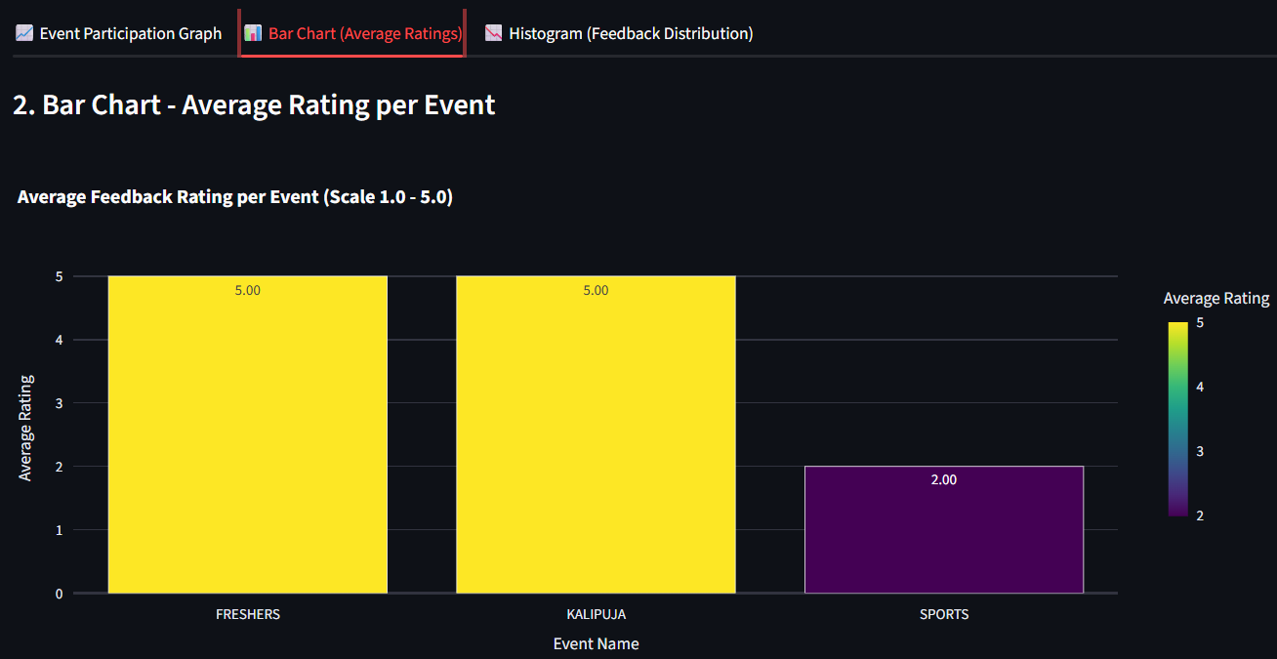
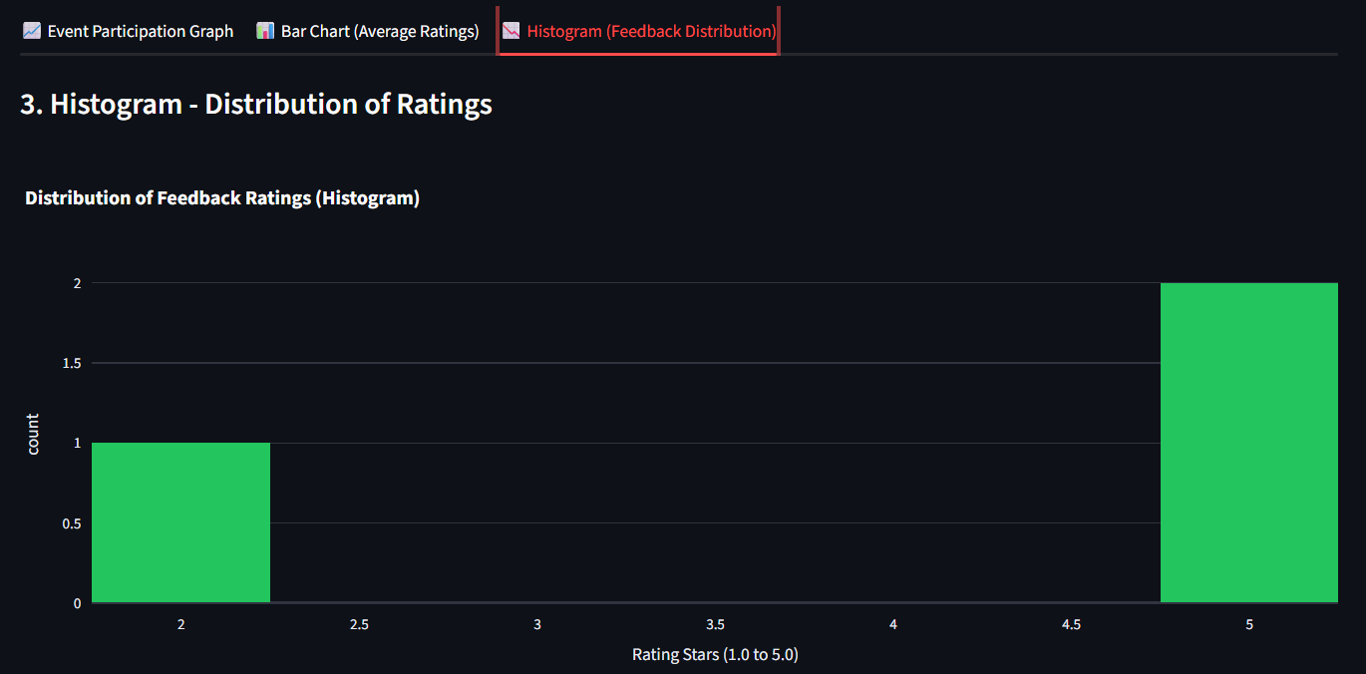
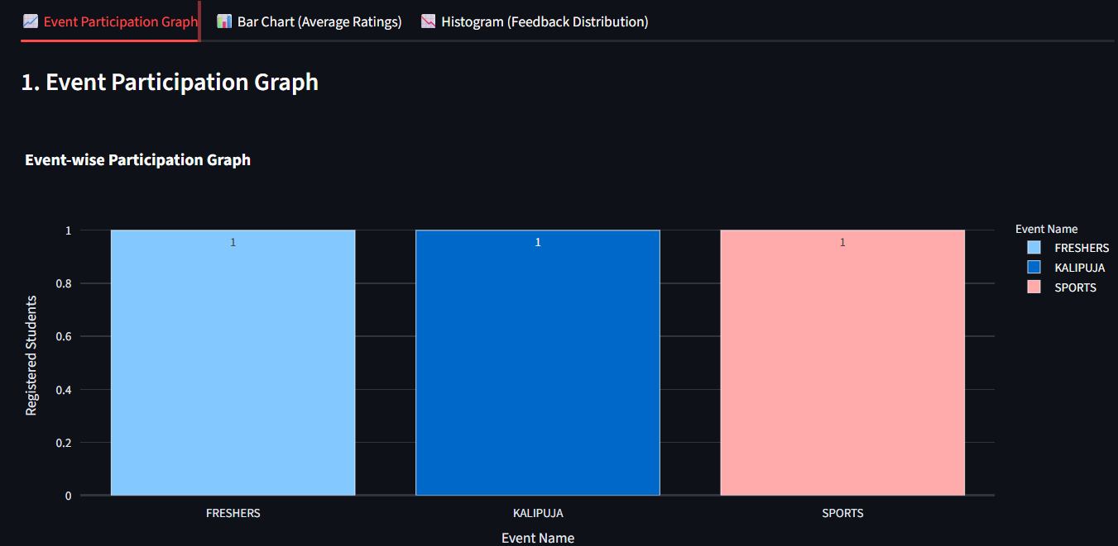
10. EVALUATION
Experimental Results & Visualizations for Charts
Bar Chart
Histogram
Event Participation Graph

Slide 11
11. SUMMARY
Project Conclusion
Objectives Achieved
Practical Value
Successfully developed an end-to-end Python analyzer that processes campus events, manages participant registrations, and generates analytical charts automatically.
Eliminates manual calculation efforts for event organizers and demonstrates practical applications of Python data science libraries in academic management.

Slide 12
12. FUTURE SCOPE
Future Enhancements & Roadmap
GUI & Web Dashboard
Database Migration
Predictive Analytics
Develop a full Streamlit or Web GUI for interactive filtering.
Replace static CSV input with PostgreSQL or SQLite database integration.
Integrate Machine Learning algorithms to predict registration turnouts.

Slide 13
Thank You
KEY REFERENCES
1. Pandas Development Team. pandas: Powerful data structures for data analysis.
2. Hunter, J. D. (2007). Matplotlib: A 2D graphics environment.
3. Project Repository Code base & MCA Documentation, Brainware University.

